Slide 1

Matrix Operations and Hamming Codes
Prof. Darrell Long
CSE 13S
Notes:
Change title picture

Slide 2
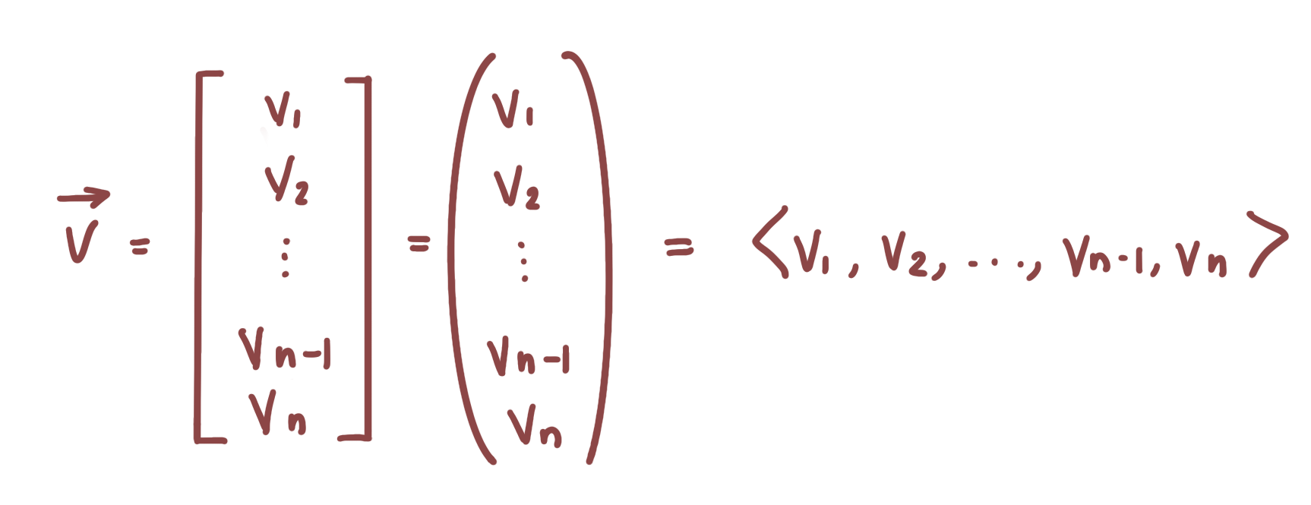
Vectors
A vector is an element of a vector space
Typically denoted as a list of ordered elements and represented as either a row or column
Can be thought of as 1-dimensional matrix
© 2021 Darrell Long

Slide 3
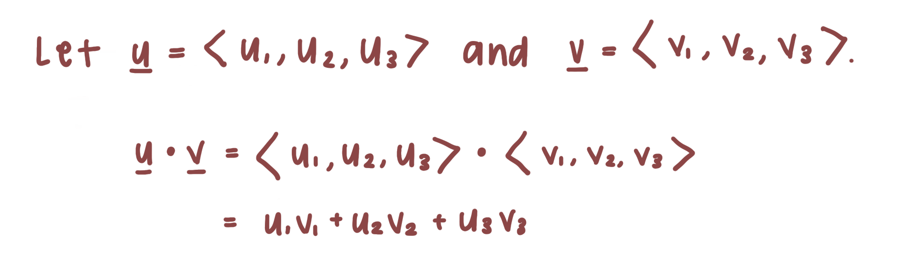
Dot Product
An operation that takes two equal length vectors and returns a single number, also known as a scalar
Can also be referred to as scalar or inner product
Difference between dot and inner product is that inner product can return a scalar, vector, or matrix
Simply put, dot product tells you the amount a vector goes in the direction of another with regards to Euclidean geometry
© 2021 Darrell Long
Notes:
Add ∑ notation

Slide 4
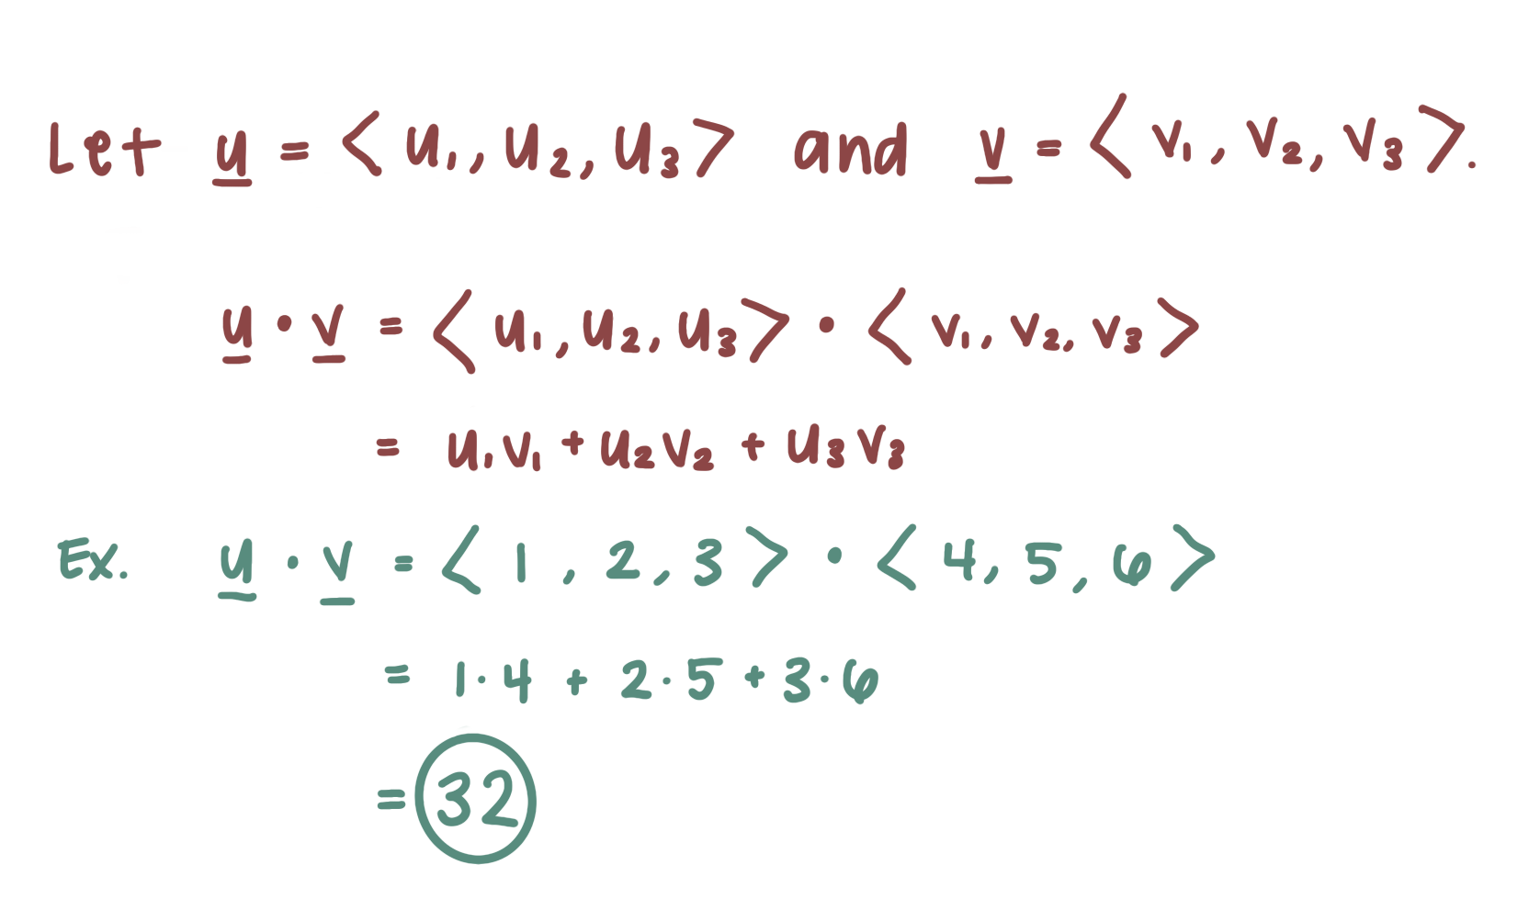
Dot Product
© 2021 Darrell Long

Slide 5
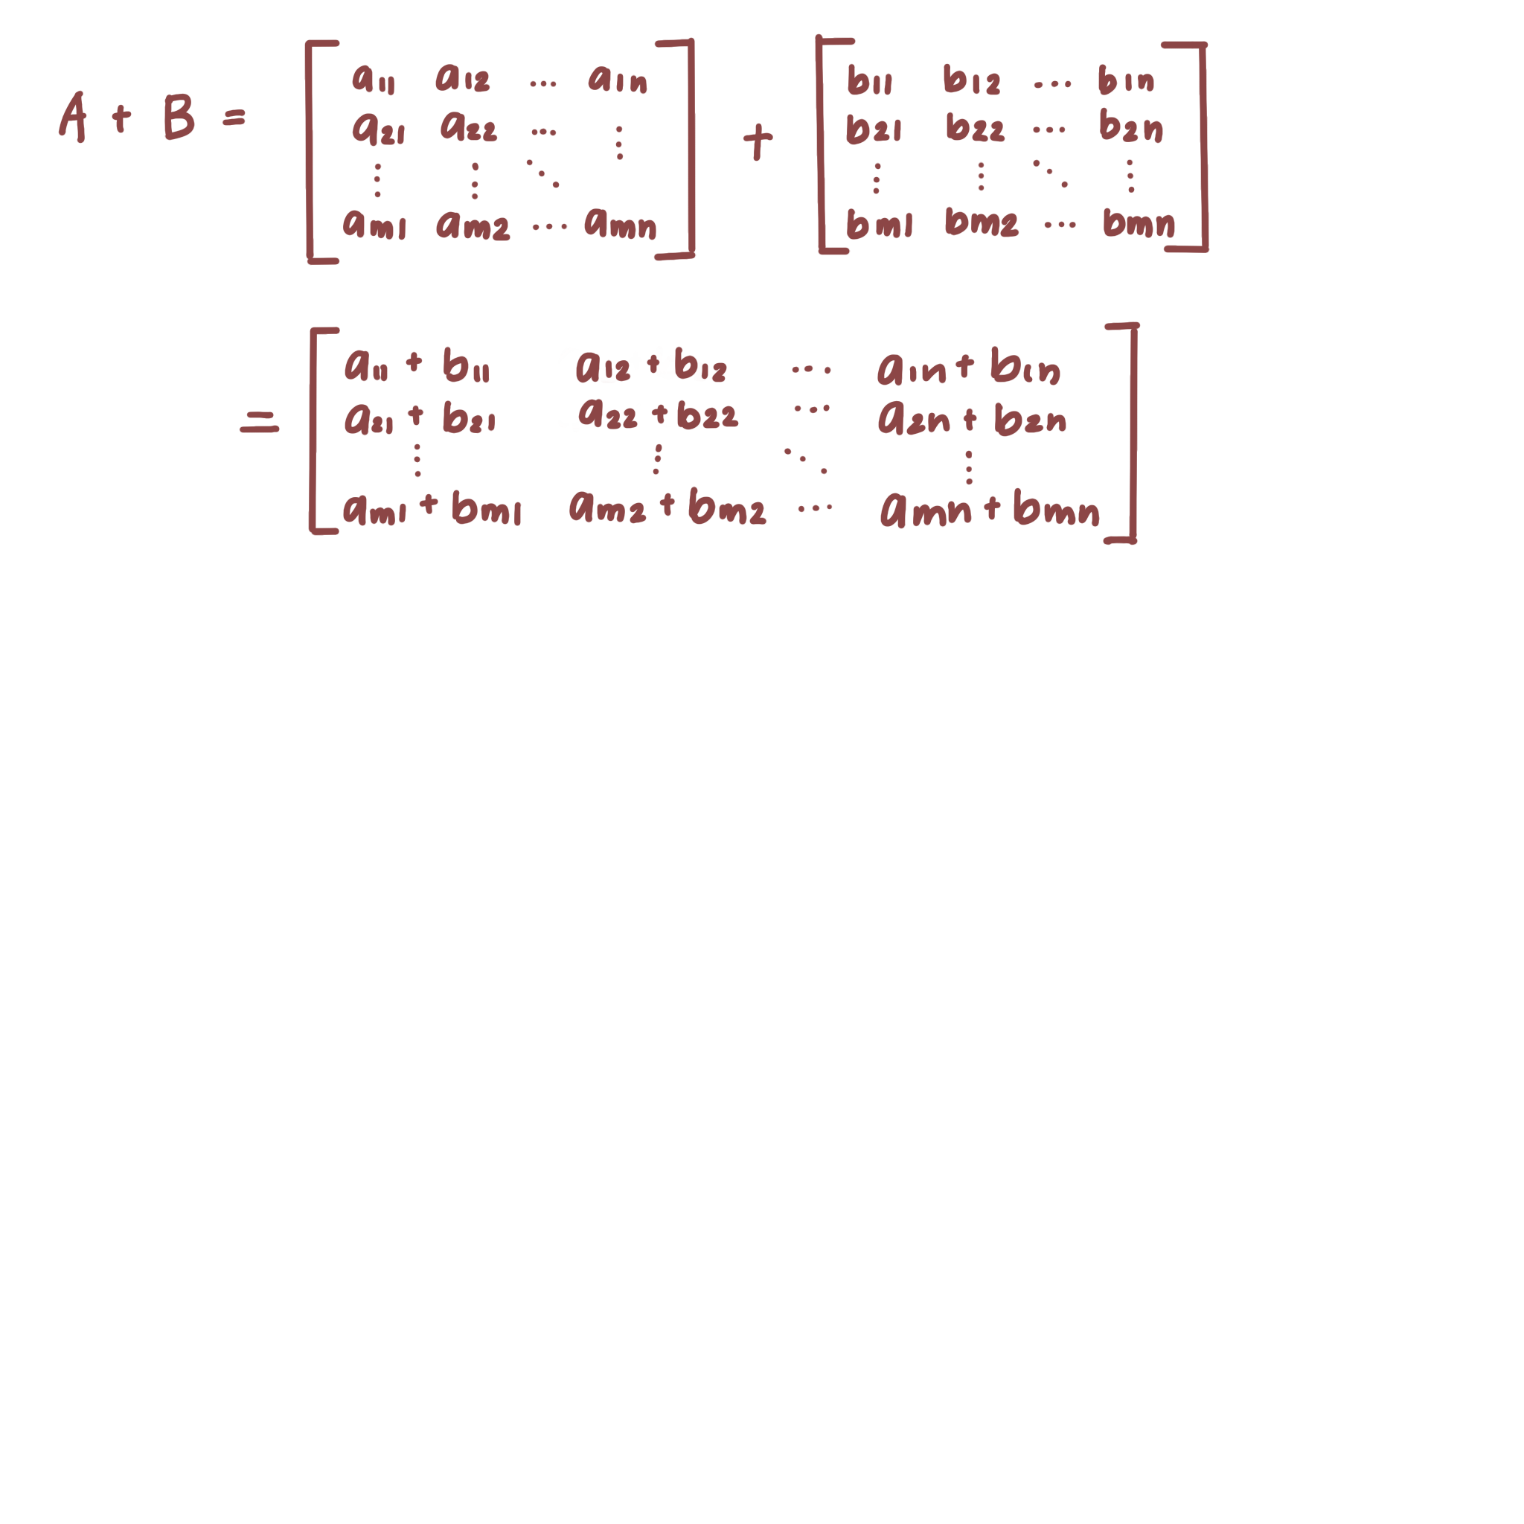
Matrices
An array of numbers organized into rows and columns
Common operations include: addition, subtraction, multiplication, transpose
For notation, each entry is denoted by a and subscript {row, column}
hi
© 2021 Darrell Long

Slide 6
Addition
In order to add two matrices, they must be of the same size (e.g. number of rows and columns are equal)
Add numbers in the same position
© 2020 Darrell Long
Notes:
Add highlights to show what is being added together

Slide 7
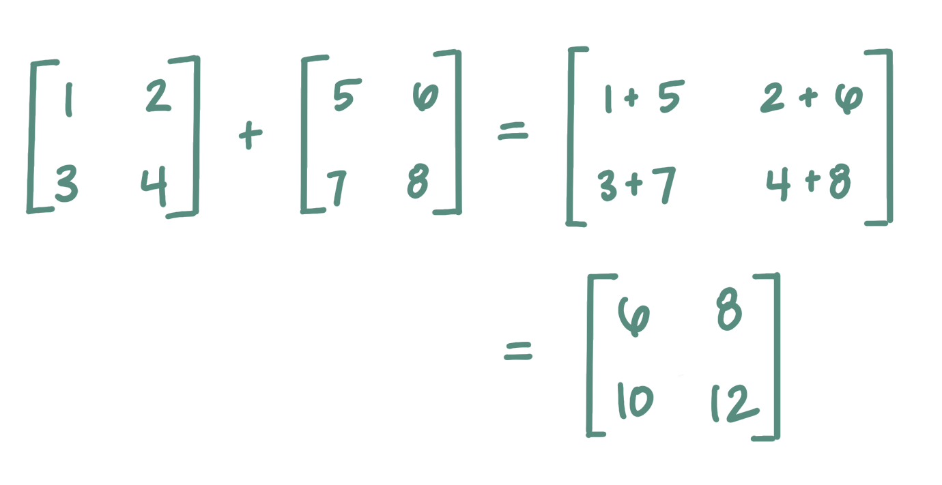
Addition
© 2020 Darrell Long
Notes:
Add highlights to show what is being added together

Slide 8

Subtraction
Same rule, matrices have to be the same size in order to subtract them
Subtract numbers in the same position
© 2020 Darrell Long

Slide 9
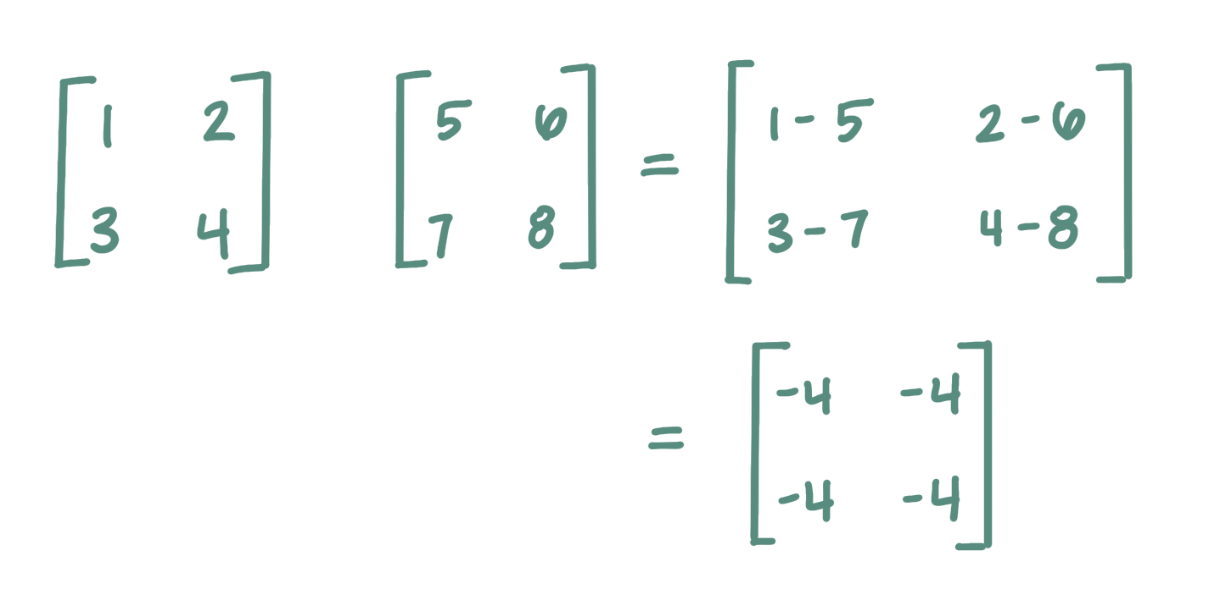
Subtraction
© 2020 Darrell Long

Slide 10
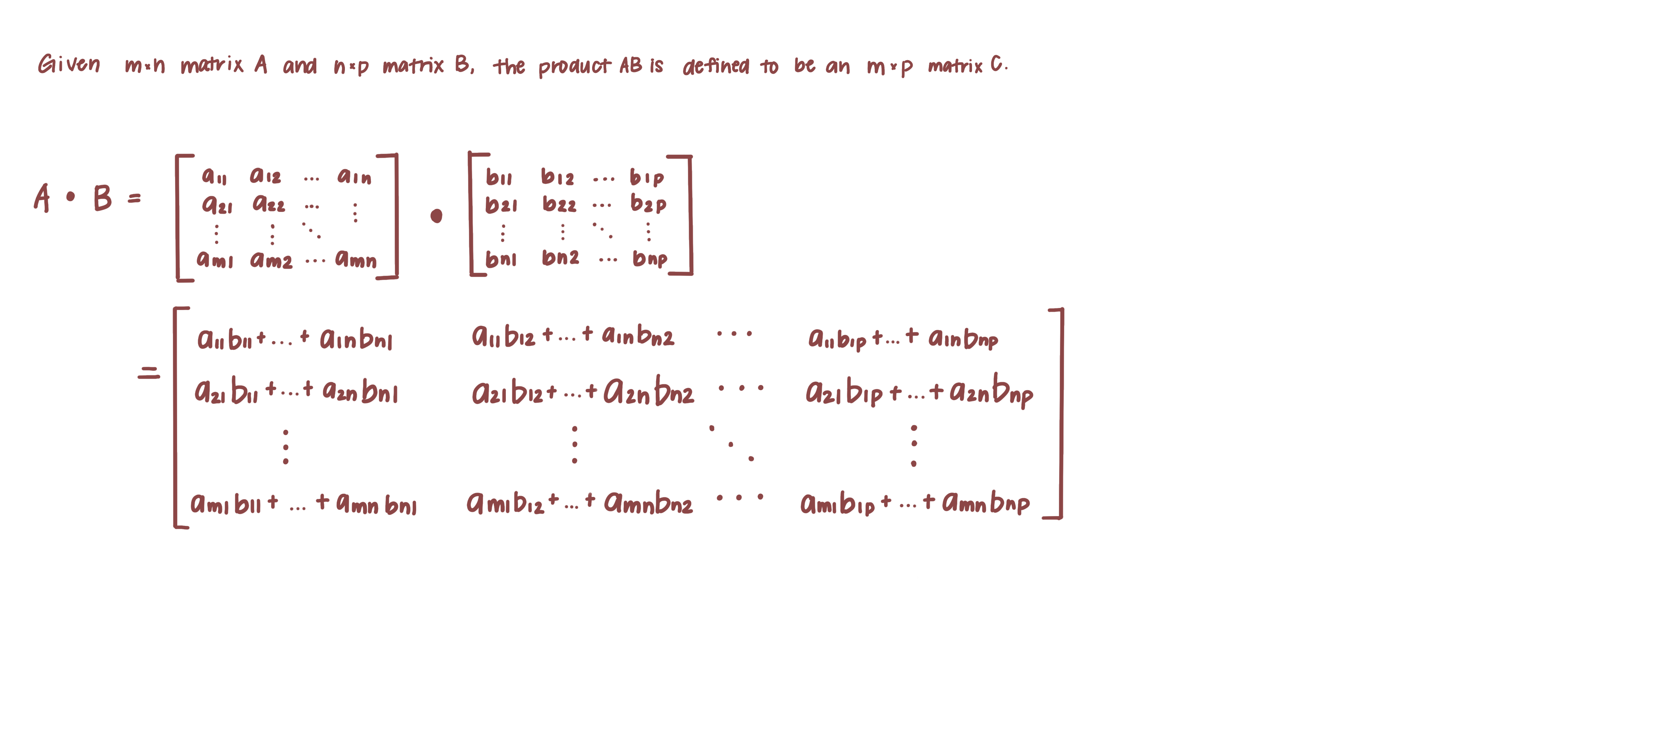
Matrix Multiplication
Before multiplying two matrices, check if the number of columns in matrix A equals number of rows in matrix B
If so, resulting matrix size is equal to the number of rows in A by number of columns in B
Use the dot product to calculate the dot product of the rows and columns
© 2020 Darrell Long

Slide 11
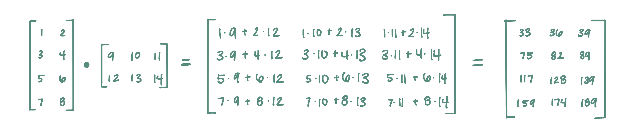
Matrix Multiplication
© 2020 Darrell Long

Slide 12
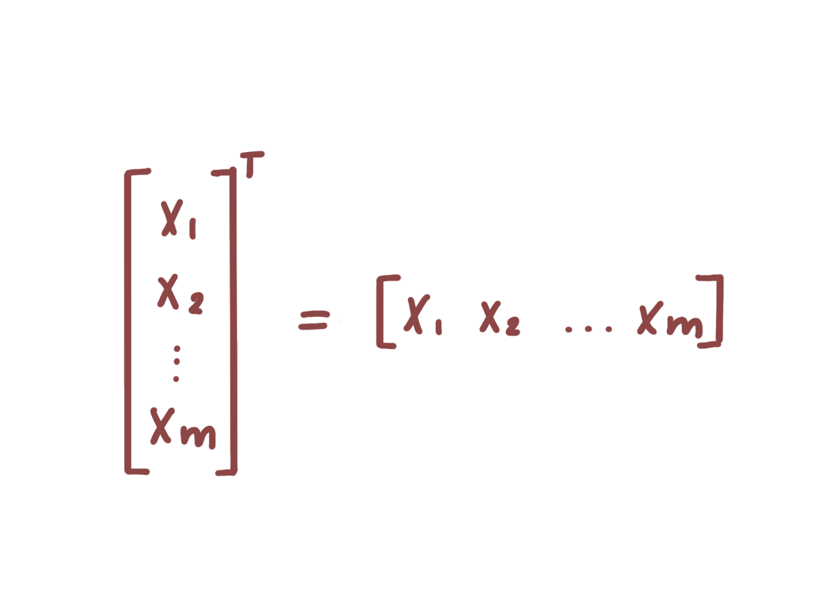
Transpose
Can be intuitively understood as “the rows become the columns and the columns become the rows”
Transpose is denoted by a “T”
What is the transpose of a 1-dimensional matrix?
© 2020 Darrell Long

Slide 13
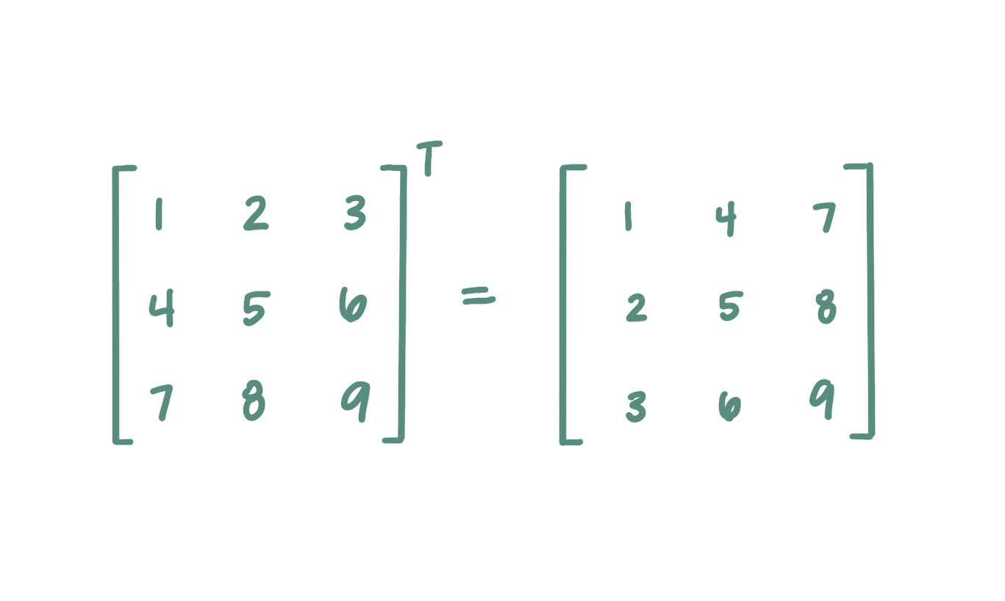
Transpose
© 2020 Darrell Long

Slide 14
Vector and Matrix Multiplication
Same conditions for multiplying two vectors applies for vector and matrix multiplication
Note that matrix multiplication is not commutative (i.e. the order in which two matrices are multiplied cannot be swapped)
© 2020 Darrell Long

Slide 15
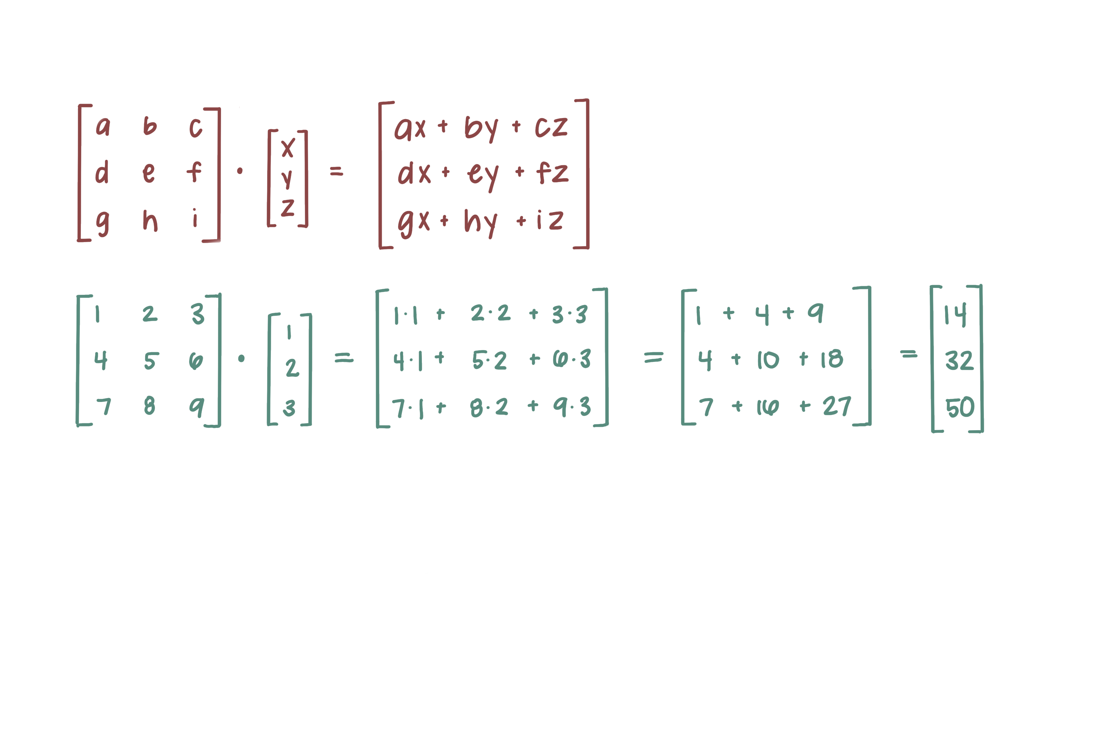
Vector and Matrix Multiplication
© 2020 Darrell Long

Slide 16
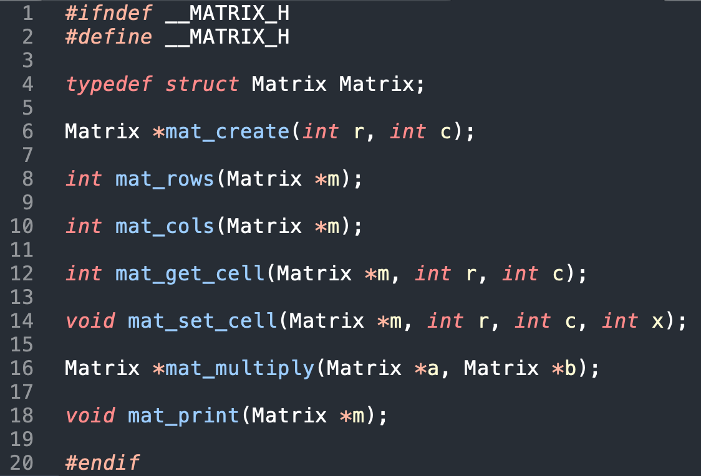
Header
© 2020 Darrell Long

Slide 17
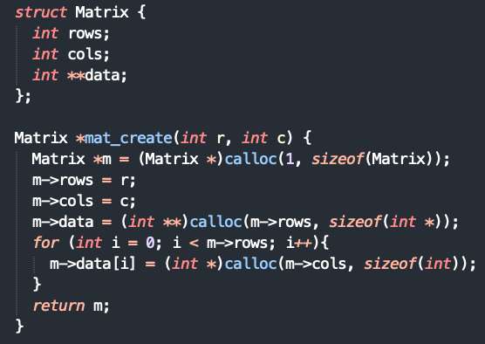

Constructor
© 2020 Darrell Long

Slide 18
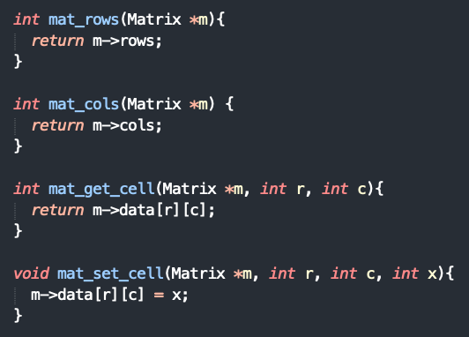

Helpers
© 2020 Darrell Long

Slide 19

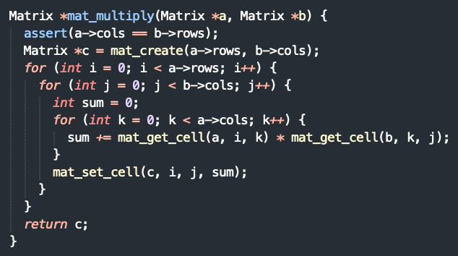
Multiplication
© 2020 Darrell Long

Slide 20
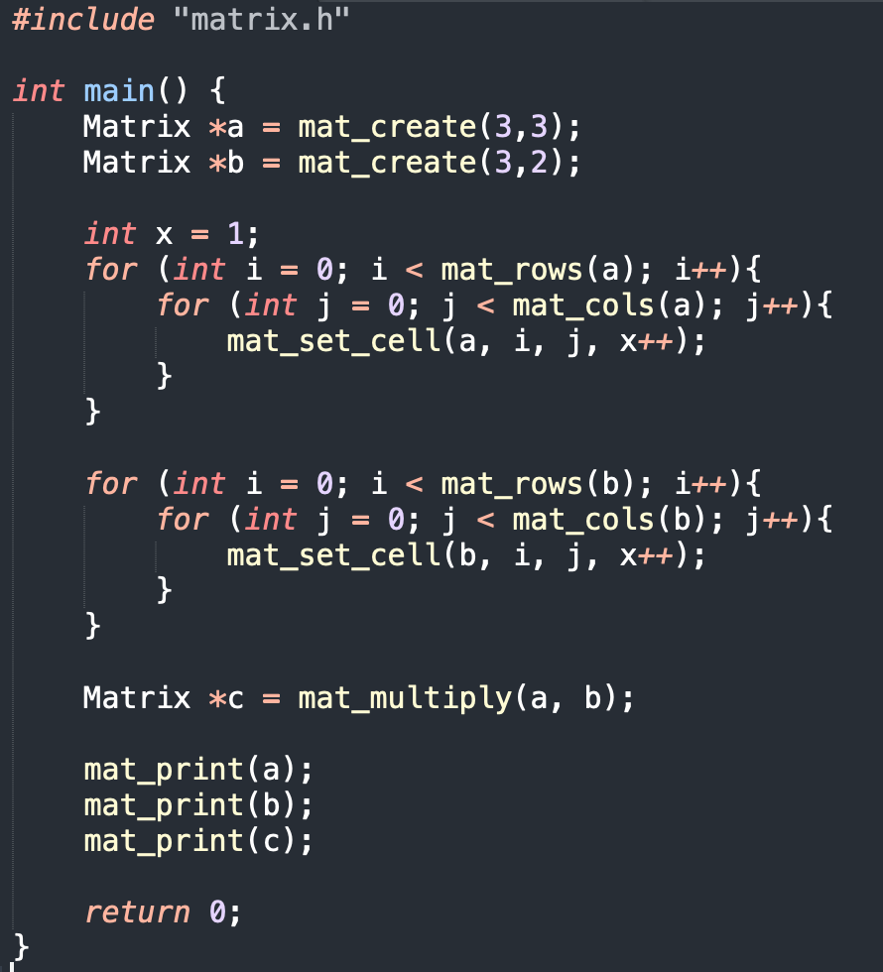
Putting it all together
© 2020 Darrell Long

Slide 21
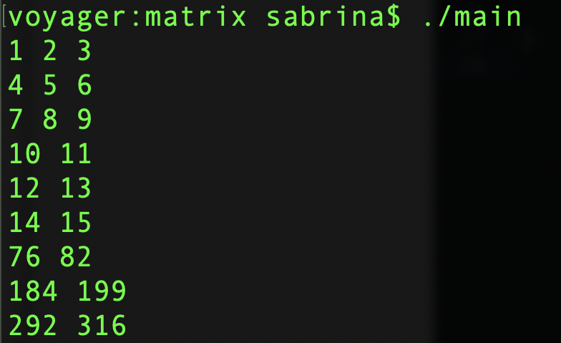
Putting it all together
Matrix A
Multiplying matrix A and B together gives us matrix C, which holds our resulting matrix product
Note: the dimensions for matrix A is 3x3 and the dimensions for matrix B is 3x2. Why?
Matrix B
Matrix C (Result)
© 2020 Darrell Long

Slide 22

So far…
Vectors, matrices, operations for vectors and matrices, transpose
© 2020 Darrell Long

Slide 23

Error Correcting Codes
Error correcting codes are an encoding technique to reliably send binary messages over channels where bits may be erroneously flipped
Not to be confused with error detection
Core idea: adding redundancy bits (a.k.a parity bits) to transmitted data which allows receiver to detect specified number of errors in message
Pioneered by Richard W. Hamming with Hamming(7,4)
You will be using them to correct errors caused by random bit-flips for your assignment
© 2020 Darrell Long

Slide 24
A bit, a nibble, and a byte walk into a bar…
Bit
A binary digit
Can only hold one of two possible values: 0 or 1 (off or on)
Nibble
Made up of 4 bits
Byte
Also made up of bits, usually 8 bits
© 2020 Darrell Long

Slide 25
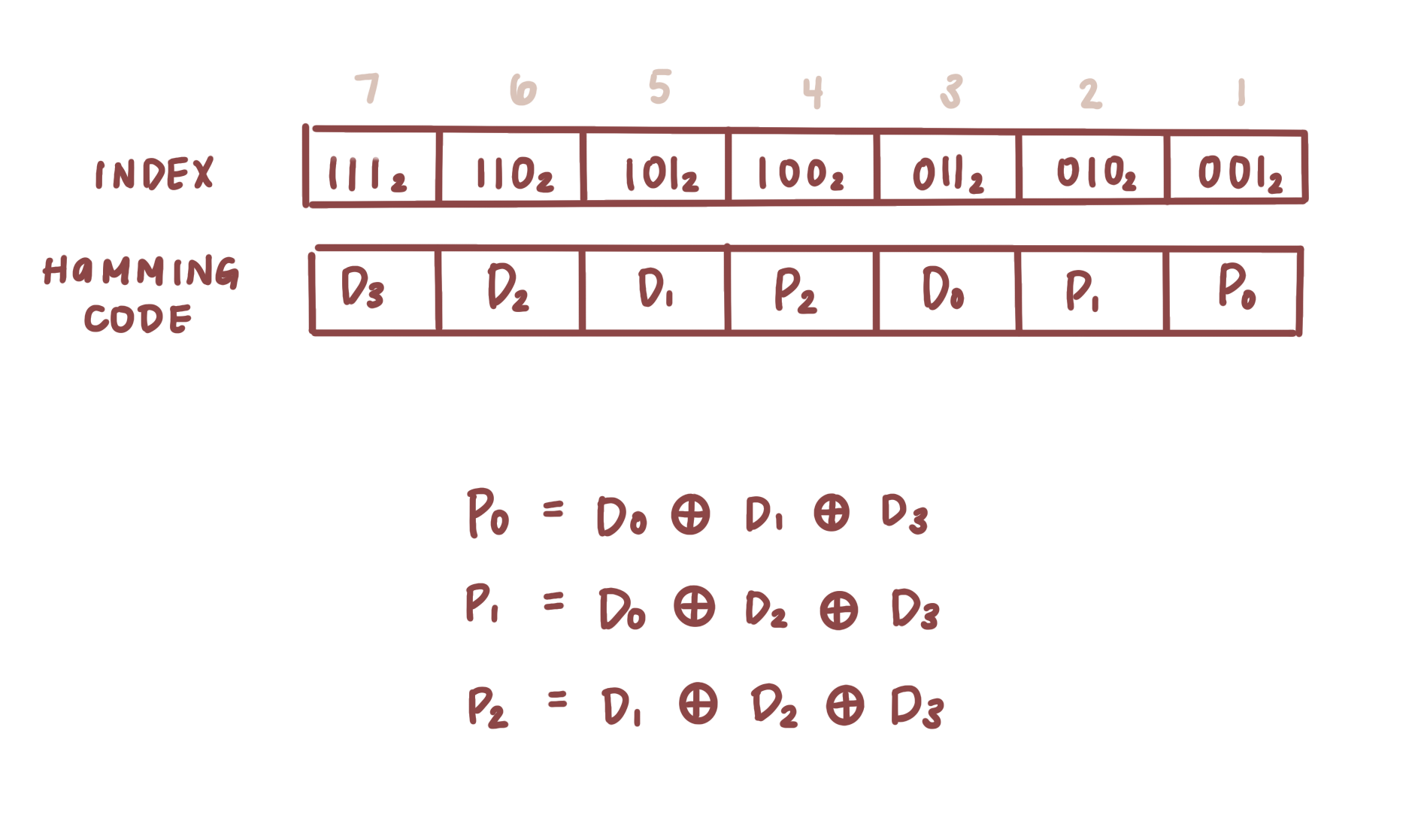
Hamming(7,4)
Hamming(7,4) is a specific type of error correcting code
It takes 4 bits of data and encodes it into 7 bits by adding 3 parity bits
Notice how the index starts at 1
Why do we add 3 parity bits?
When starting from an index of 1, we need at least 3 bits to identify which bit may have been flipped
© 2020 Darrell Long

Slide 26
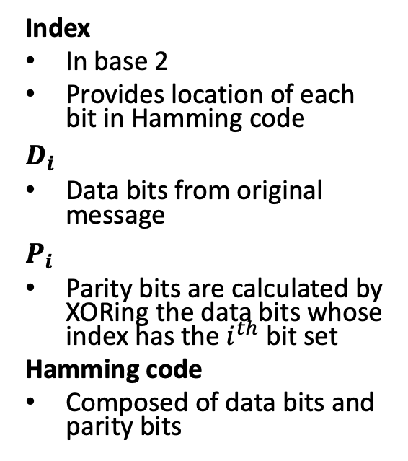
Hamming(7,4)
Index
In base 2
Provides location of each bit in Hamming code
$$D_{i}$$
Data bits from original message
$$P_{i}$$
Parity bits are calculated by XORing the data bits whose index has the $i^{th}$ bit set
Hamming code
Composed of data bits and parity bits
© 2020 Darrell Long

Slide 27
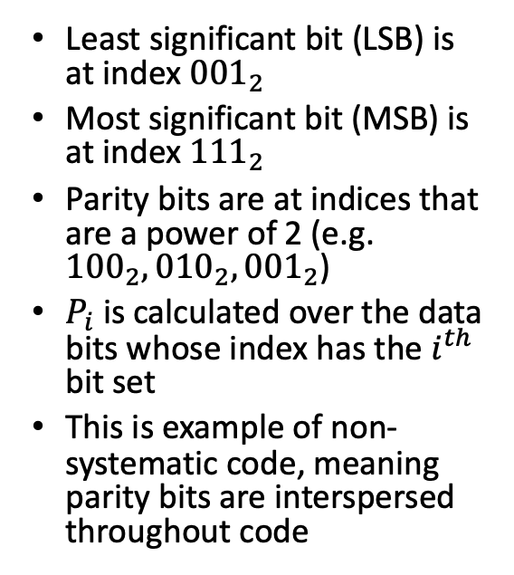
Parity Bits
Least significant bit (LSB) is at index ${001}_{2}$
Most significant bit (MSB) is at index ${111}_{2}$
Parity bits are at indices that are a power of 2 (e.g. ${100}_{2},{010}_{2},{001}_{2}$)
$P_{i}$is calculated over the data bits whose index has the $i^{th}$ bit set
This is example of non-systematic code, meaning parity bits are interspersed throughout code
© 2020 Darrell Long

Slide 28
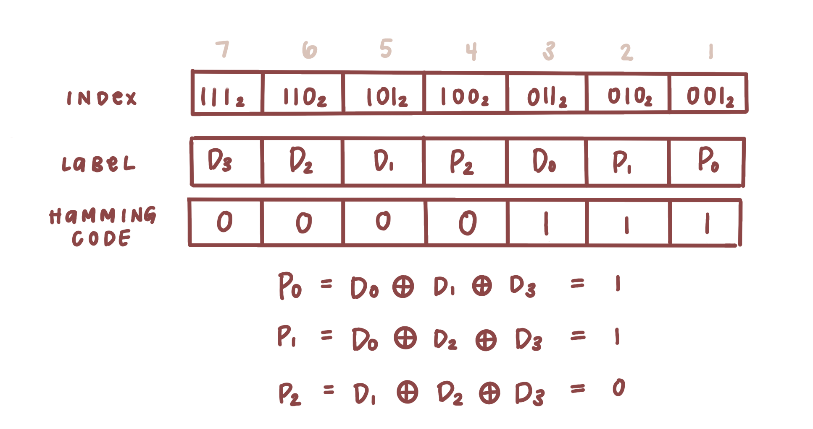
Calculating parity bits
© 2020 Darrell Long

Slide 29
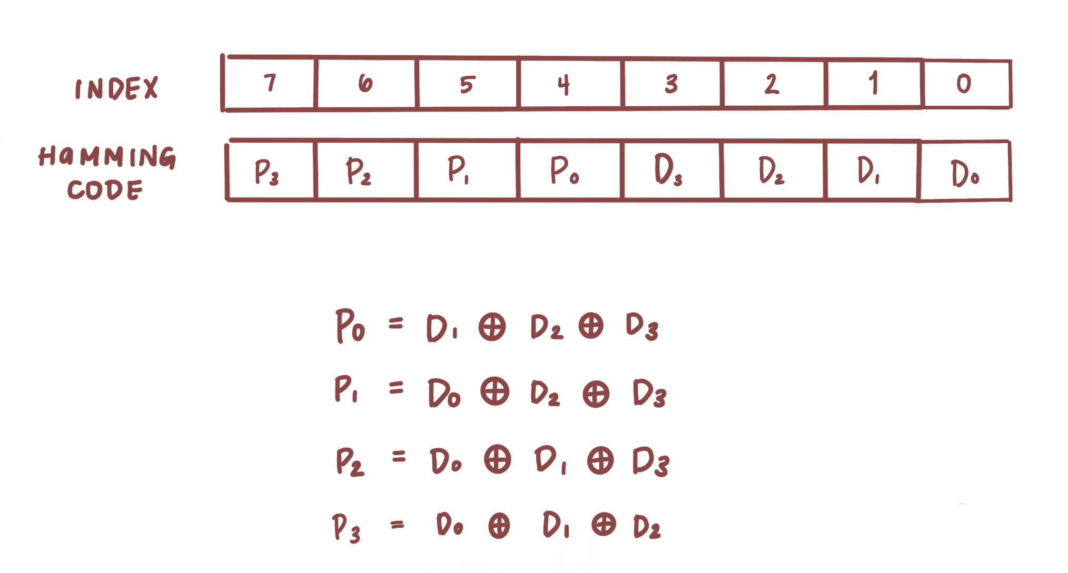
Hamming(8,4)
For your assignment, you will be following a Hamming(8,4) scheme
4 bits of data will encoded into 8 bits by adding 4 parity bits
Codes are now a byte long rather than 7 bits and can now detect 2 errors
This is an example of systematic code, meaning the data bits and parity bits are grouped together
© 2020 Darrell Long

Slide 30
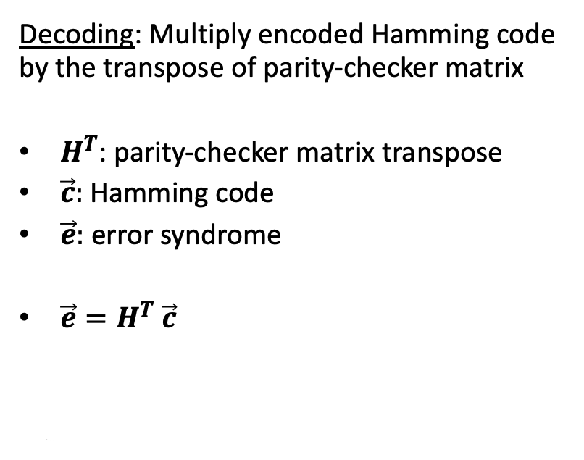
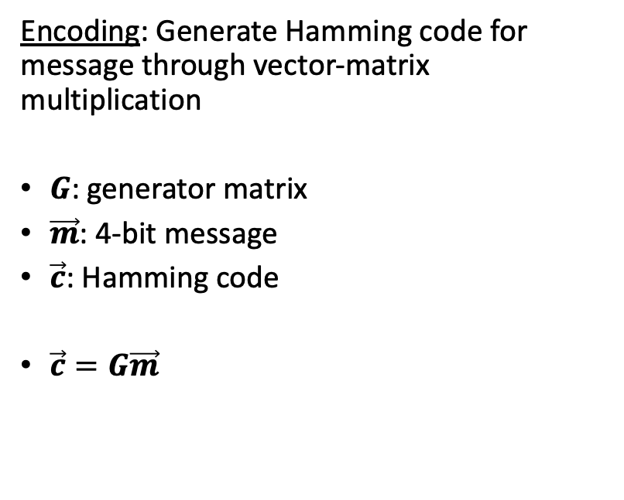
Encoding
Decoding
Encoding: Generate Hamming code for message through vector-matrix multiplication
$G$: generator matrix
$\vec{m}$: 4-bit message
$\vec{c}$: Hamming code
$\vec{c}=G\vec{m}$
Decoding: Multiply encoded Hamming code by the transpose of parity-checker matrix
$H^{T}$: parity-checker matrix transpose
$\vec{c}:$ Hamming code
$\vec{e}:$error syndrome
$\vec{e}=H^{T}$ $\vec{c}$
Error serre
© 2020 Darrell Long

Slide 31
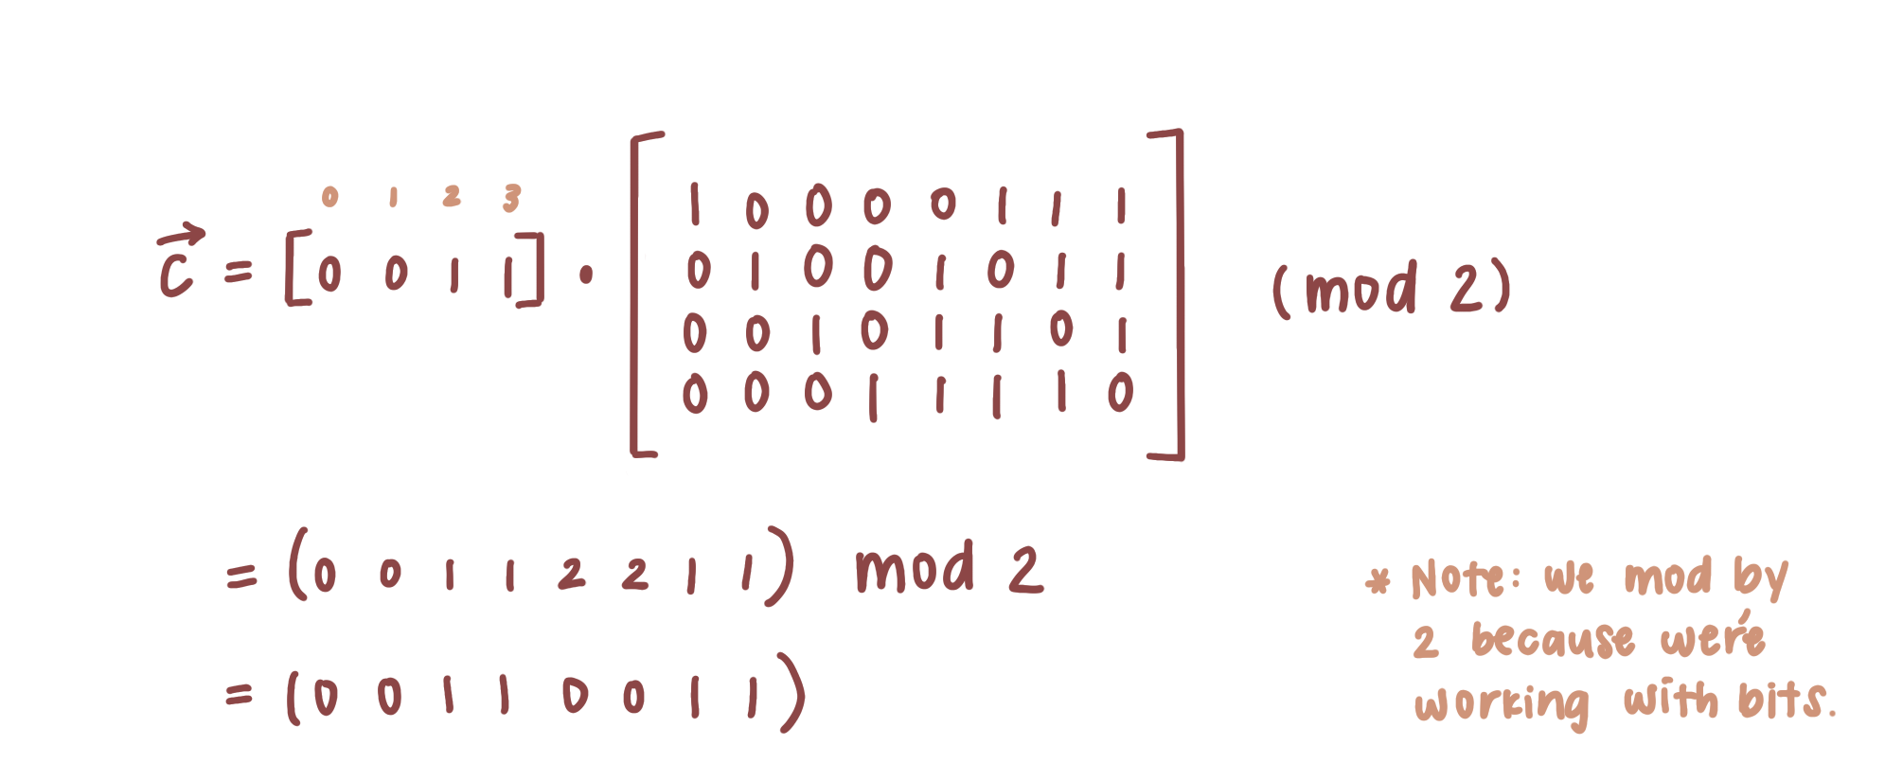
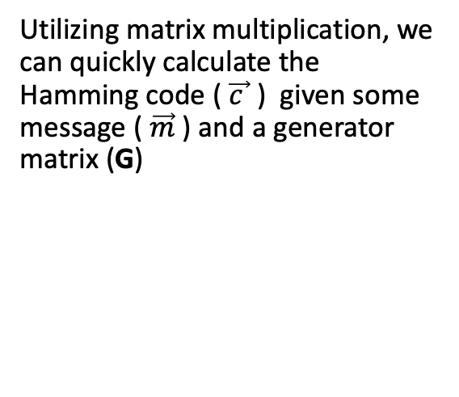
Encoding with Hamming Codes
Utilizing matrix multiplication, we can quickly calculate the Hamming code ($\vec{c }$) given some message ( $\vec{m}$) and a generator matrix (G)
© 2020 Darrell Long

Slide 32
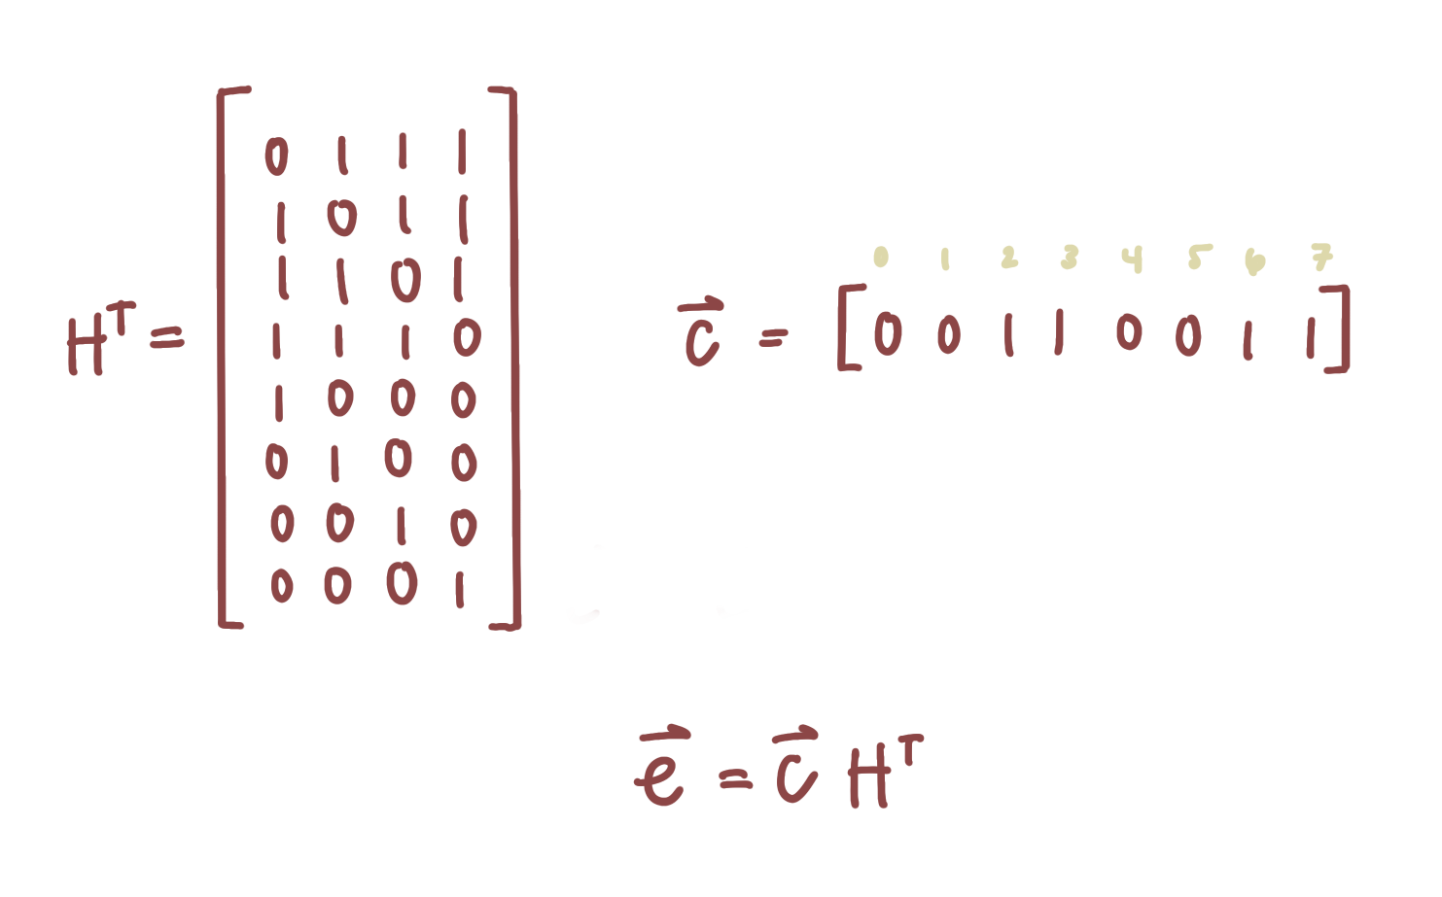
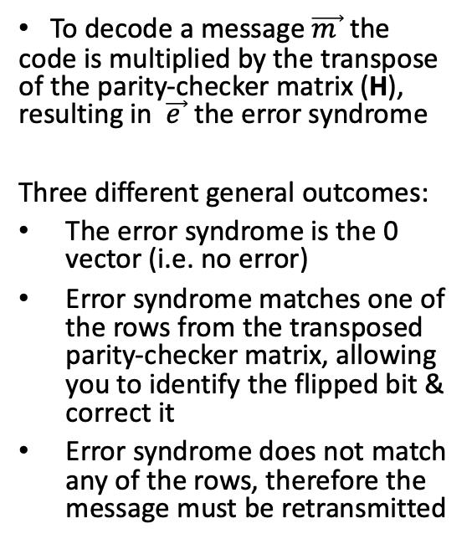
Decoding with Hamming Codes
To decode a message$\vec{m }$the code is multiplied by the transpose of the parity-checker matrix (H), resulting in $\vec{e }$the error syndrome
Three different general outcomes:
The error syndrome is the 0 vector (i.e. no error)
Error syndrome matches one of the rows from the transposed parity-checker matrix, allowing you to identify the flipped bit & correct it
Error syndrome does not match any of the rows, therefore the message must be retransmitted
© 2020 Darrell Long

Slide 33
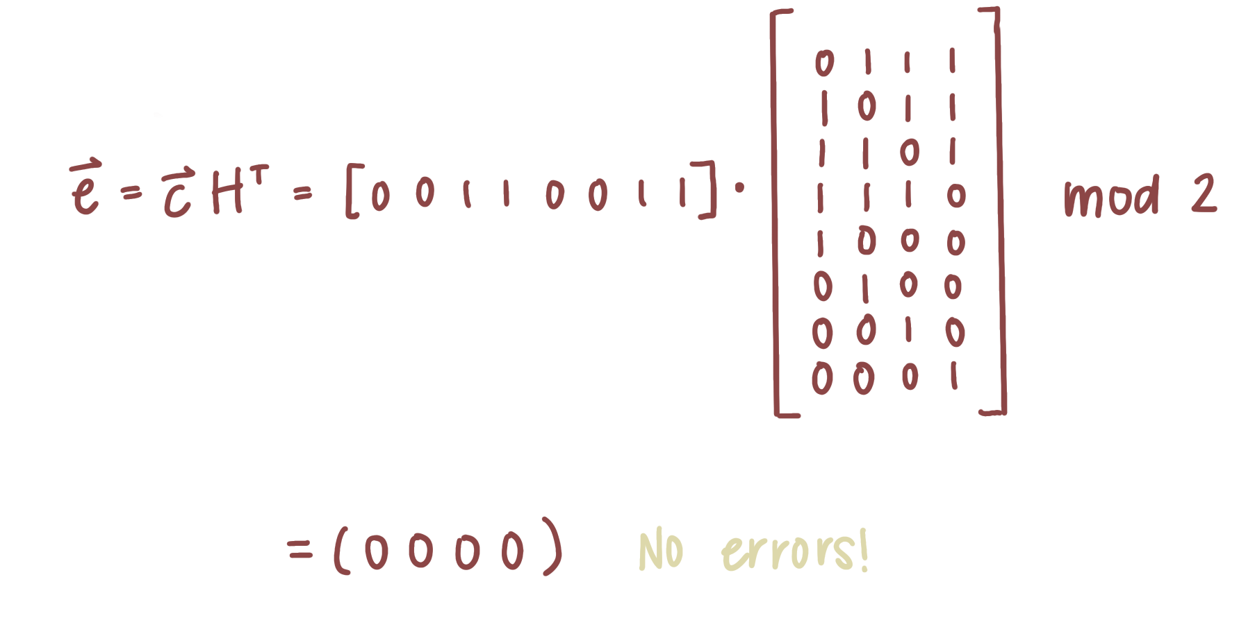
Decoding with no error
© 2020 Darrell Long

Slide 34
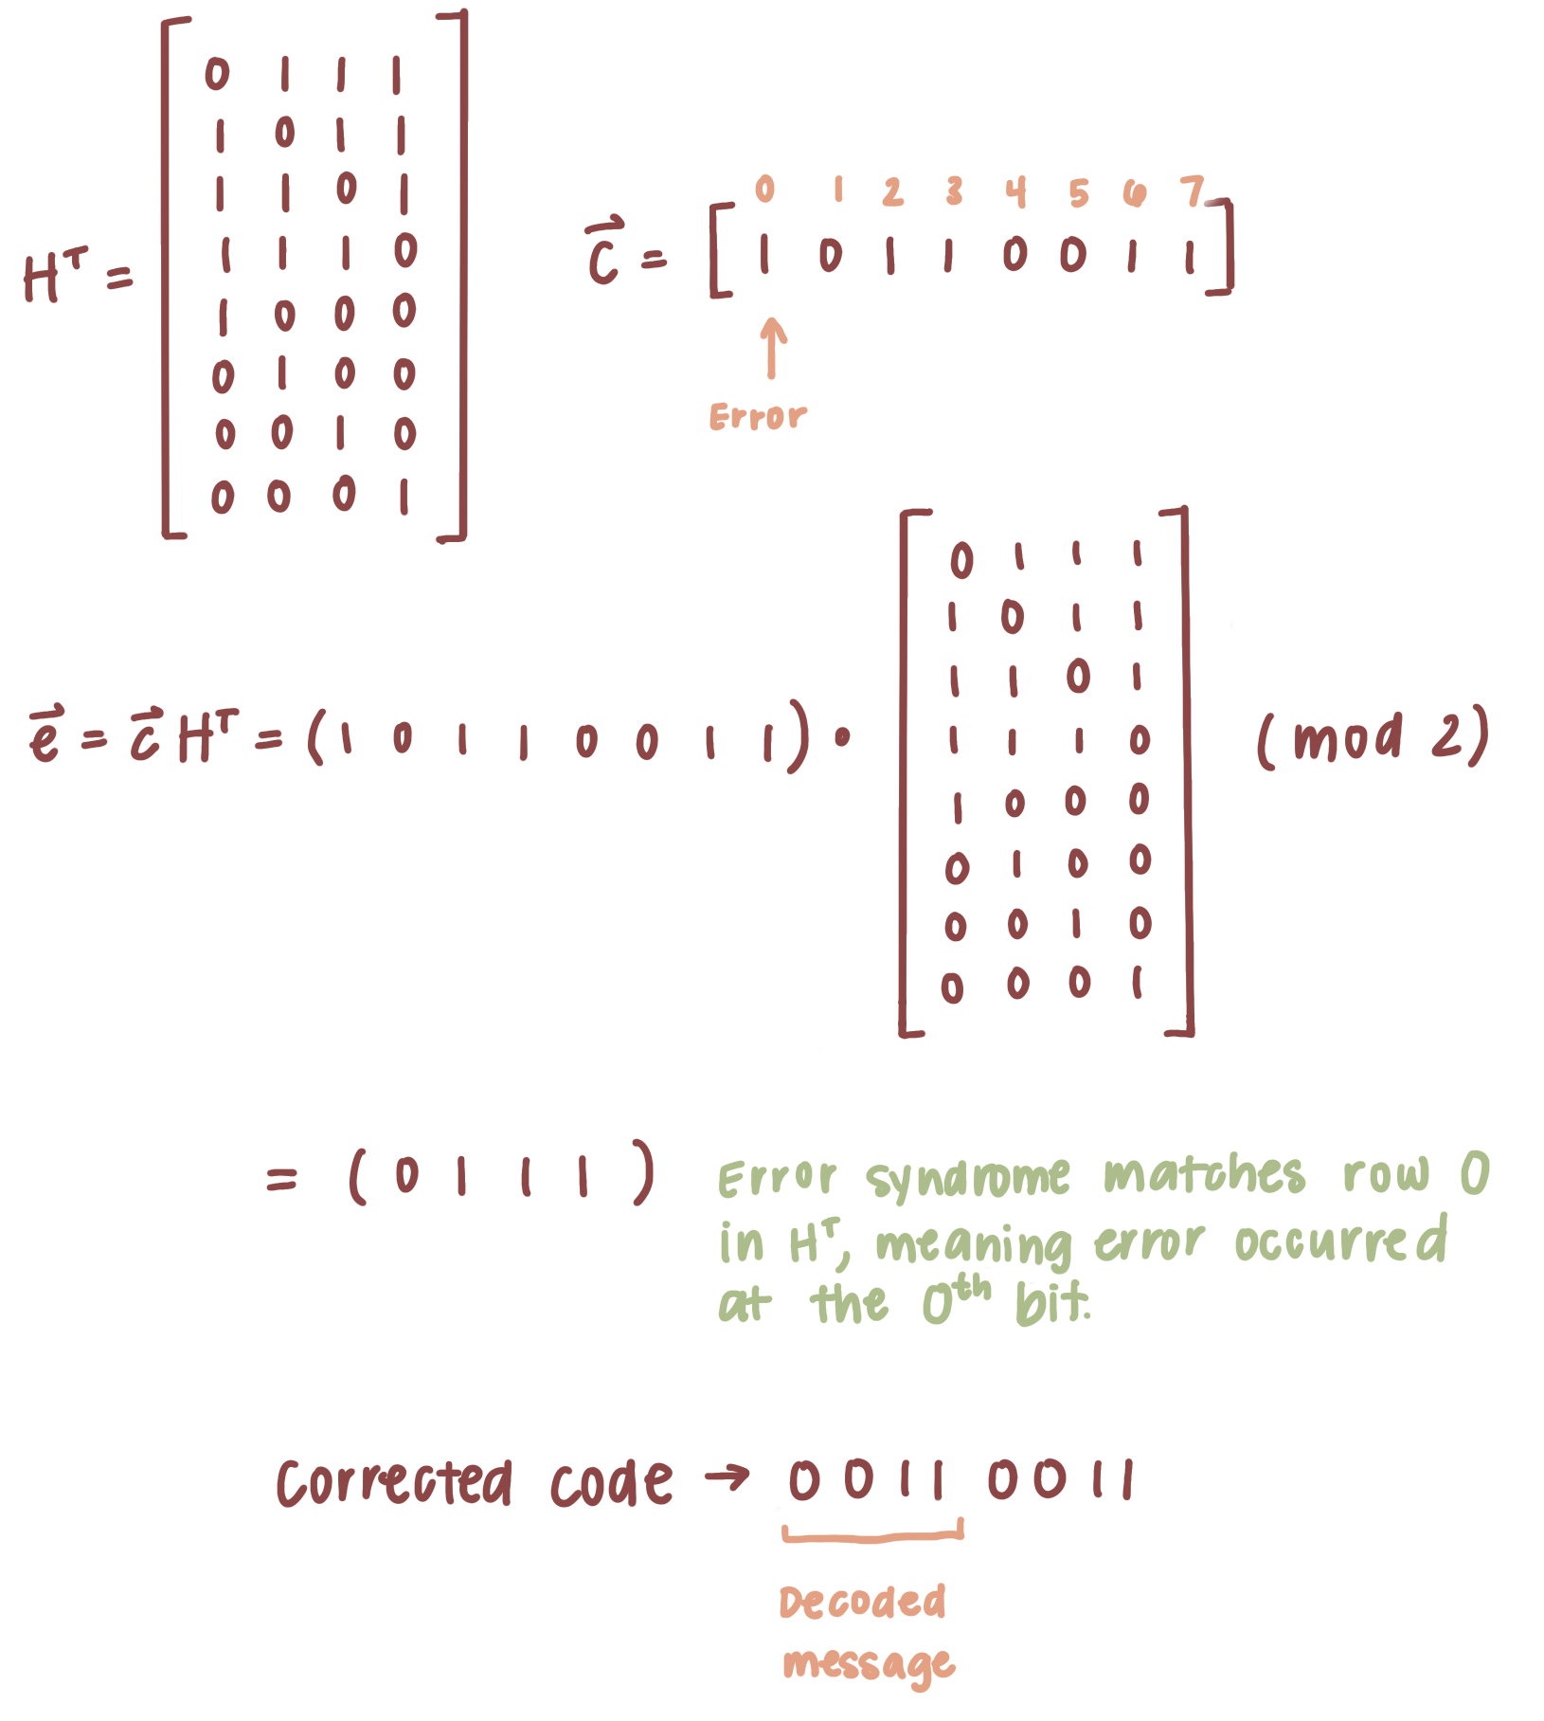
Decoding with error
© 2020 Darrell Long

